Slide 1
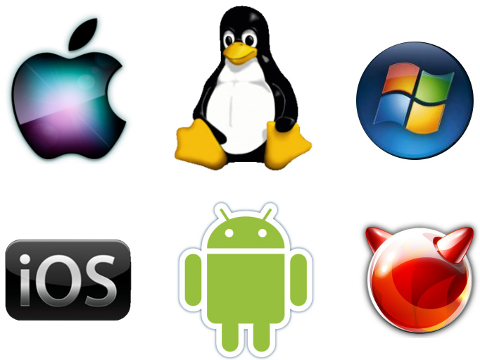
Operating System (O.S)
Lect-1

Slide 2
Computer System Components
The basic resource of a computer system are provided by its
Hardware, Software and Data
Hardware:
Physical Devices
Provides basic computing resources
Operating System:
Provide simple interface between application program and hardware
Controls and coordinates the use of hardware among application programs.
Application Programs
Solve computing problems of users (compilers, database systems, video games, business programs such as banking software).
Users
People, machines, other computers
Interact with system by using application program to perform particular task

Slide 3
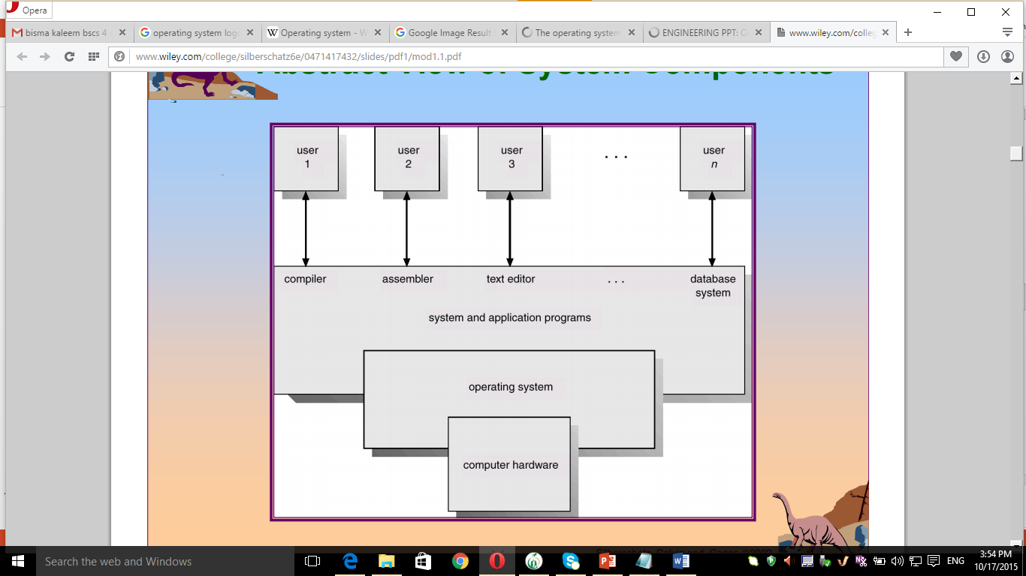
Abstract View of System Components

Slide 4
Operating System
An Operating System is a program that act as intermediately between the user and hardware
O.S act as interface between the user and hardware
O.S provide an environment where user execute application program
OS simplifies and manages the complexity of running application programs efficiently.
O.S provide proper mean to use these component
O.S is just a government itself that cannot do useful task, it just provide an environment in which another program do useful task
O.S Controls and coordinates the use of hardware among application programs for different user.
Without Operating System computer would be useless

Slide 5
Operating System
Manages the computer’s resources (hardware, abstract resources, software)
It’s a resource allocator.
It is also used to control programs to prevent
errors and improper computer use.
It is interrupt driven.
In the 1960s, Moore’s Law predicted that the number of transistors on an integrated circuit would double every eighteen months, and that prediction has held true. Computers gained in functionality and shrunk in size, leading to a vast number of uses and a vast number and variety of operating systems.

Slide 6
Goal of O.S
Primary Goal:
The Primary Goal of O.S is to make the computer more convenient to user
Secondary Goal:
The Secondary Goal of O.S is to use the computer in efficient manner
O.S

Slide 7
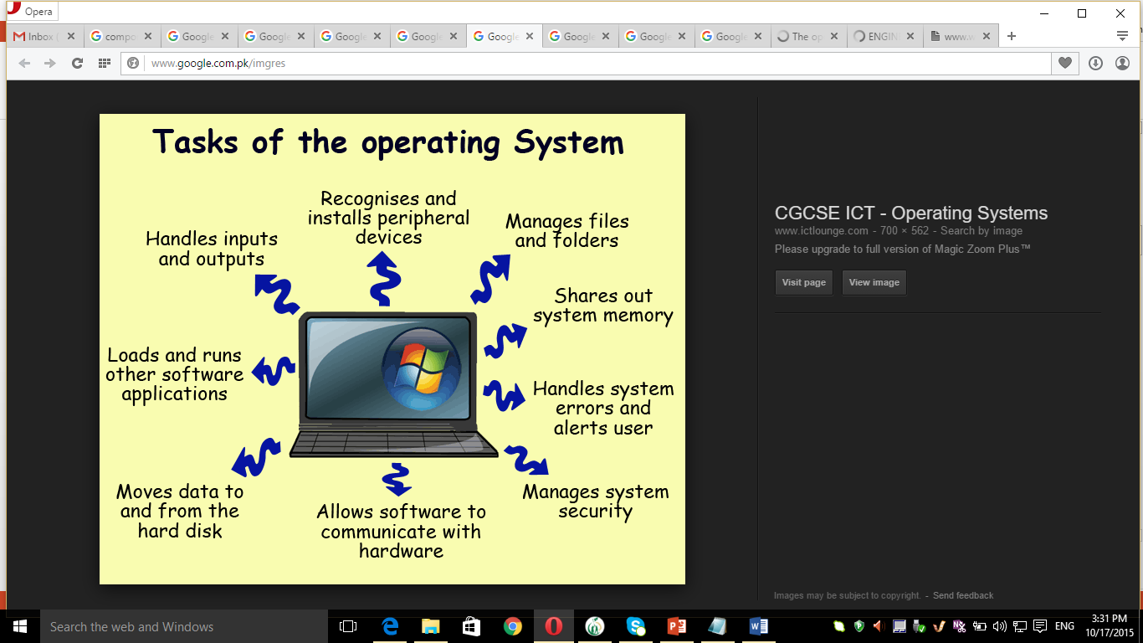

Slide 8
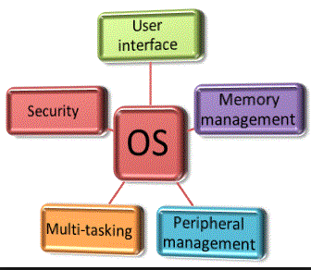

Slide 9
Some OS Tasks
Program Execution
An OS has to be able to load a program into memory and run that program. Also, this program needs to be able to end execution, whether normally or abnormally.
I/O Operations
A running program may require I/O in the form of a file or an output device.
Due to a security or efficiency need, users often do not control I/O, so the OS must provide the means for I/O.
File-system manipulation
Programs need to able to read and write to files, also delete, rename, and remove them.
It is also necessary that files have permission functionality to provide additional security.

Slide 10
OS Tasks
Communication
Often times one process must communication with another process.
Communication may be between the processes of a single computer, or computers connected via a network.
Communication may be implemented via shared memory or through message passing.
Error detection
An OS should be constantly looking for errors, and know how to handle them.
For each error, the OS should have an action to take to ensure correct and consistent computing.
Debugging facilities enhance user and development usage of the system.

Slide 11
OS Efficiency Functions
Resource Allocation
Multiple users or jobs require that resources be allocated to each one.
Some resources have a special allocation code, while others may have more general request and release code.
Protection and Security
It should not be possible for one process to interfere with other processes or the OS itself.
This means that all access to system resources is controlled.
Protecting the system from outside threats is done through authenticating users, and to defending external I/O devices.
Log files can help detect and track attempts of outside infiltration.

Slide 12
What is a kernel, what is an operating system?
An operating system is a set of software that makes a computer work. It is the back bone of all software in a computer, allowing other software to be installed and executed. Without an operating system, you cannot use a computer.
A kernel is the most important element of an operating system. For an OS to work, it needs a kernel. The task of the kernel is to handle hardware resources (memory allocation, disk access, device usage...). It sits in between the hardware and the software being executed.
O.S is also called kernel is a program that run all the time in computer in kernel mode
O.S is software that run into the kernel mode and protected from user tempering by hardware

Slide 13
Kernel
The kernel is the central module of an operating system (OS).
It is the part of the operating system that loads first, and it remains inmain memory.
Typically, the kernel is responsible for
Memory management
Process and task management
Disk management.
The kernel connects the system hardware to the application software.
Every operating system has a kernel. For example the Linux kernel is used numerous operating systems including Linux, FreeBSD, Android and others.

Slide 14
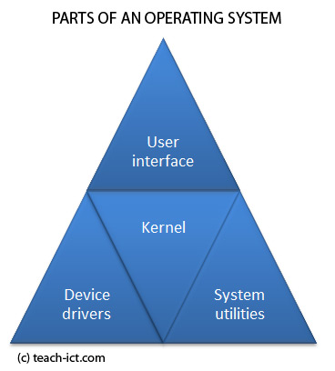
Parts of an operating system
The operating system can be broken down into four main parts, namely
Kernel
Device Drivers
User Interface
System Utilities

Slide 15
Kernel
This has the task of loading the applications into memory, making sure they do not interfere with one another and allowing them to share use of the CPU efficiently. The kernel also handles file storage to and from secondary storage devices such as hard disks and optical drives.
In other words the kernel handles:
Loading / Unloading applications from memory
Scheduling tasks to run on the CPU
Memory management
File management
Data security

Slide 16
Device Drivers
Every piece of hardware that makes up the computer or connected to it, will have a device driver that allows the operating system to control and communicate with it. There could be hundreds of device drivers pre-installed with the operating system, and the right ones for that particular computer set-up is loaded on boot-up.
The exact detail of which device driver is needed by the operating system is kept in a file - in Windows, the file is called the 'registry' and in Linux the details will be stored as a number of 'configuration files'.
Makers of printers, graphics tablets, scanners, digital cameras and so on, will normally provide device drivers for each make of operating system. A device driver for Windows is different from the device driver for Linux.
This is why if you remove an operating system such as Windows from a hard disk, and install Linux instead, you will need to make sure you have all the correct device drivers available for each piece of hardware.

Slide 17
User interface
This part of the operating system is directing what you see on the screen (via the device driver) and reacting to your key presses and other inputs. The user interface could be a basic command line interface, as you might find on a server, or it might be a full blown Graphical User Interface (GUI) such as the Mac OS X, Windows or perhaps Gnome on Linux.
System Utilities
This part of the operating system provides all the basic facilities that run in the background without user interaction. For example,
Print spool services
Cryptographic password management.
File management services

Slide 18
Single User, Single application
This type of operating system only has to deal with one person at a time, running one user application at a time.
An example of a this kind of operating system would be the operating system of a basic mobile phone or an mp3 player.
There can only be one user using the device and that person is only using one of its applications at a time.
But it still has the same fundamental parts as all the other types of operating system.
Example of an MP3 player
A mp3 player contains a computer to handle all of its functions. It has a small amount of memory and a number of specialist silicon chips.
The operating system is installed in memory and runs as soon as you switch on the device.

Slide 19
Single User, Multi-tasking
You will find this kind of operating system on a personal computer. The operating system is designed mainly with a single user in mind, but it can deal with many applications running at the same time.
Another word for Multi-tasking is Multi-programming
Example operating systems are
Windows
Linux
Mac OS X

Slide 20
Multi-User, Multi-Tasking
This kind of operating system can be found on Mainframe and Supercomputers.
They are highly sophisticated and are designed to handle many people running their programmes on the computer at the same time.
Examples of this kind of operating system include various versions of UNIX, Linux, IBM's z/OS, OS/390, MVS and VM
When a program is being executed in memory, this is called a 'process'. You can have many people using the same process at the same time. Each person is running a 'thread' of execution within the process.
For example, say a programmer, lets call him Joe, wants to compile his source code. The operating system will load the correct compiler into memory as a process and set up a single thread for Joe to start using it.

